Slide 1
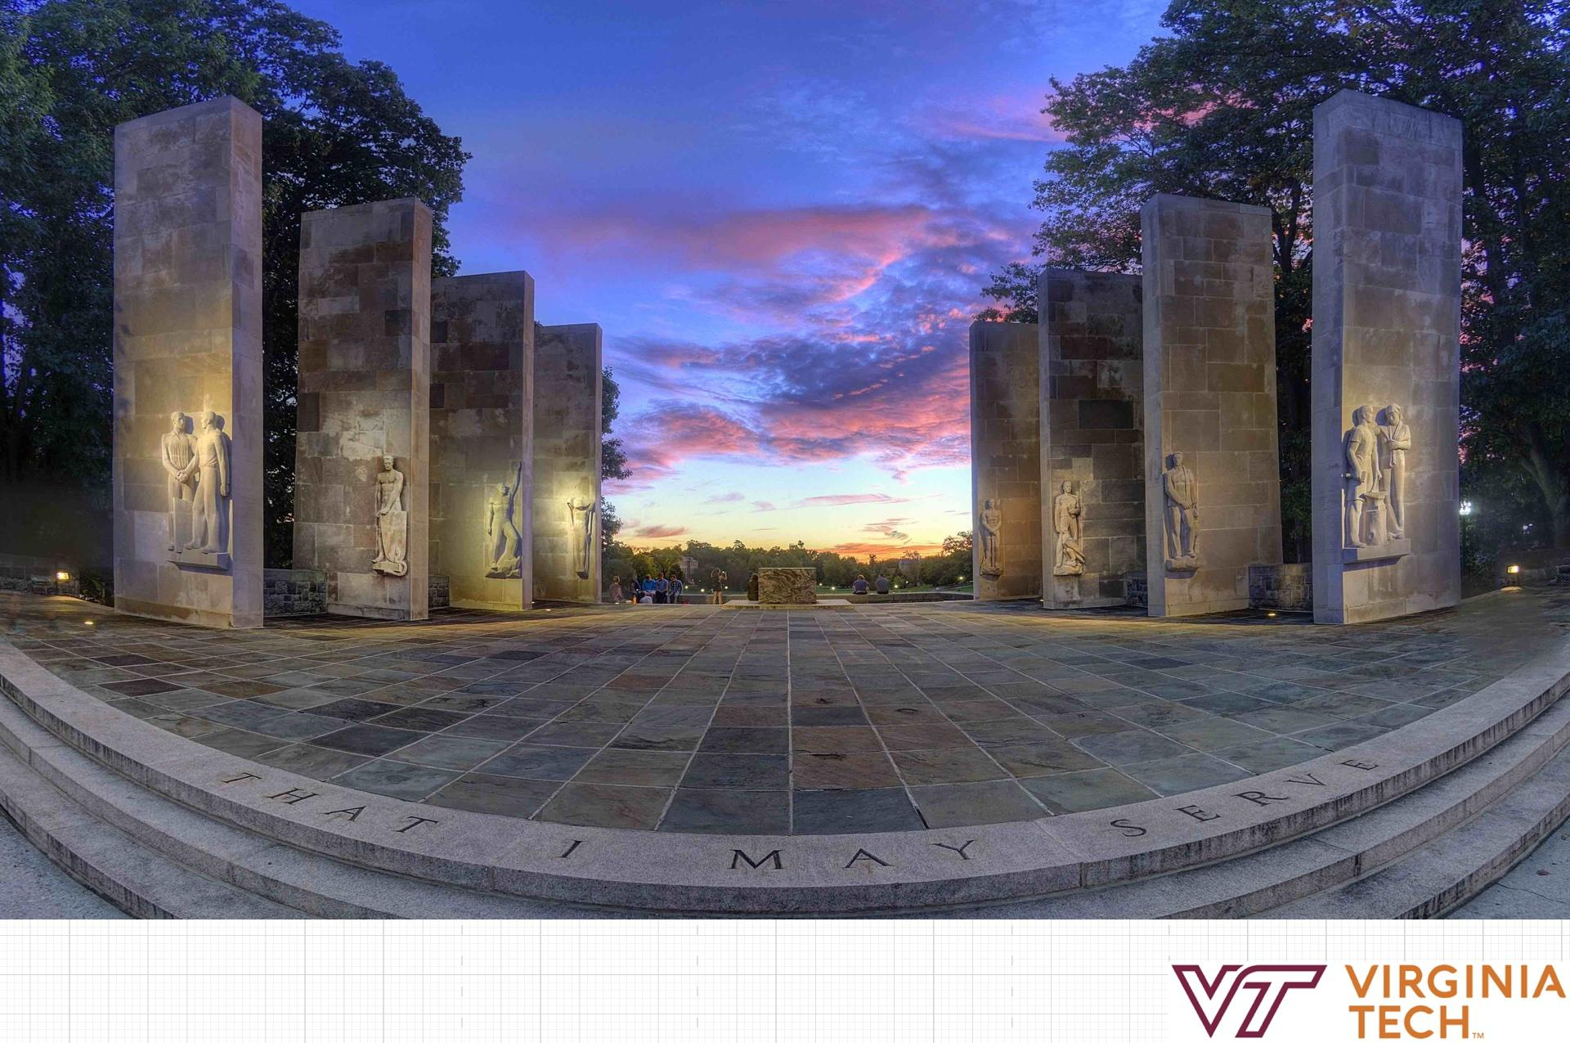
Immersive Reality Travel
Mobile Mixed Reality-Focus Group Presentation
Wenjun Han, Gram Hsing, Harsh Sanghavi, Tianzi Wang
Notes:
: Good afternoon everyone! We are mobile platform research group, I am ……

Slide 2
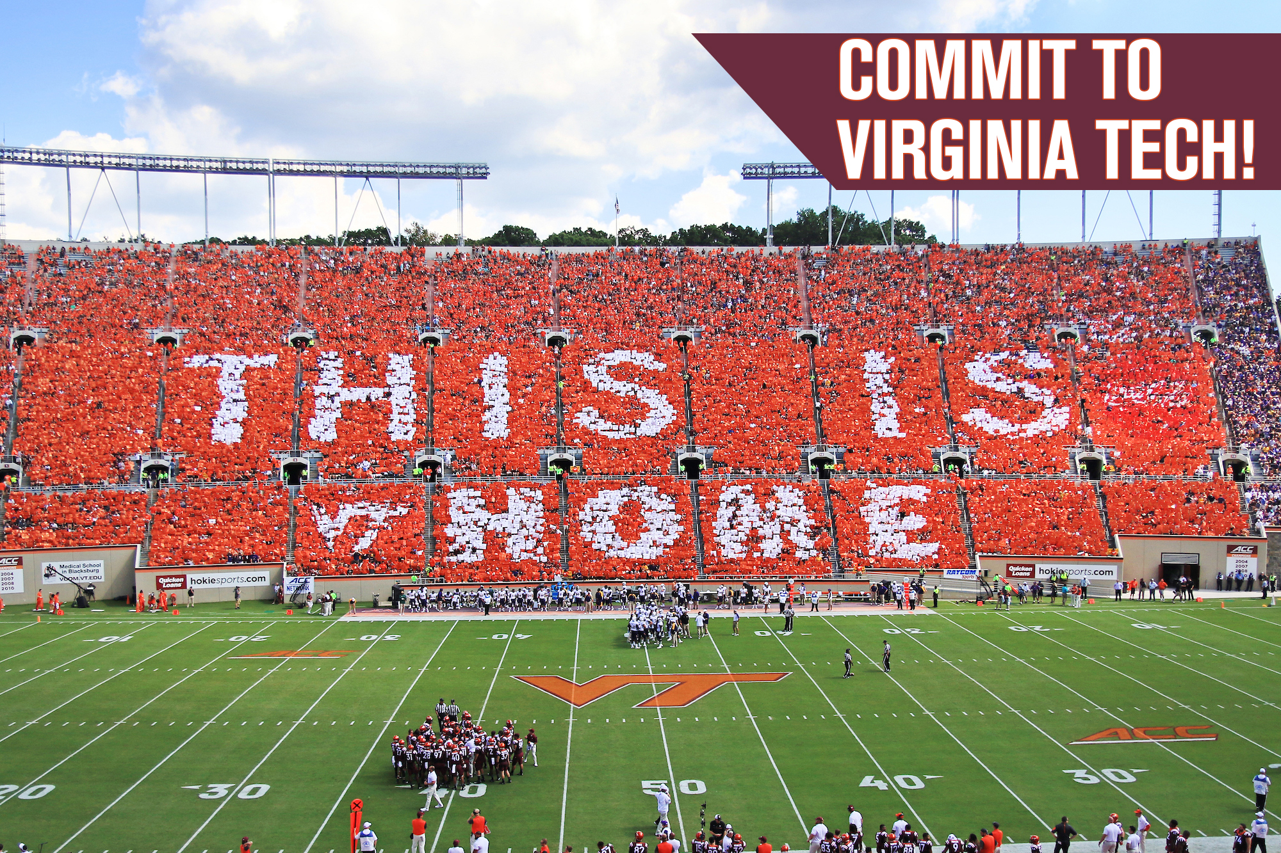
Outline
Introduction
Content
Key Takeaways
Design Ideas
Conclusion
Reflections
Notes:
Picture: https://hokieclub.com/
In this presentation, we will talk about what we asked and what we learned during our focus group. And how those information can inspire our idea in design.

Slide 3
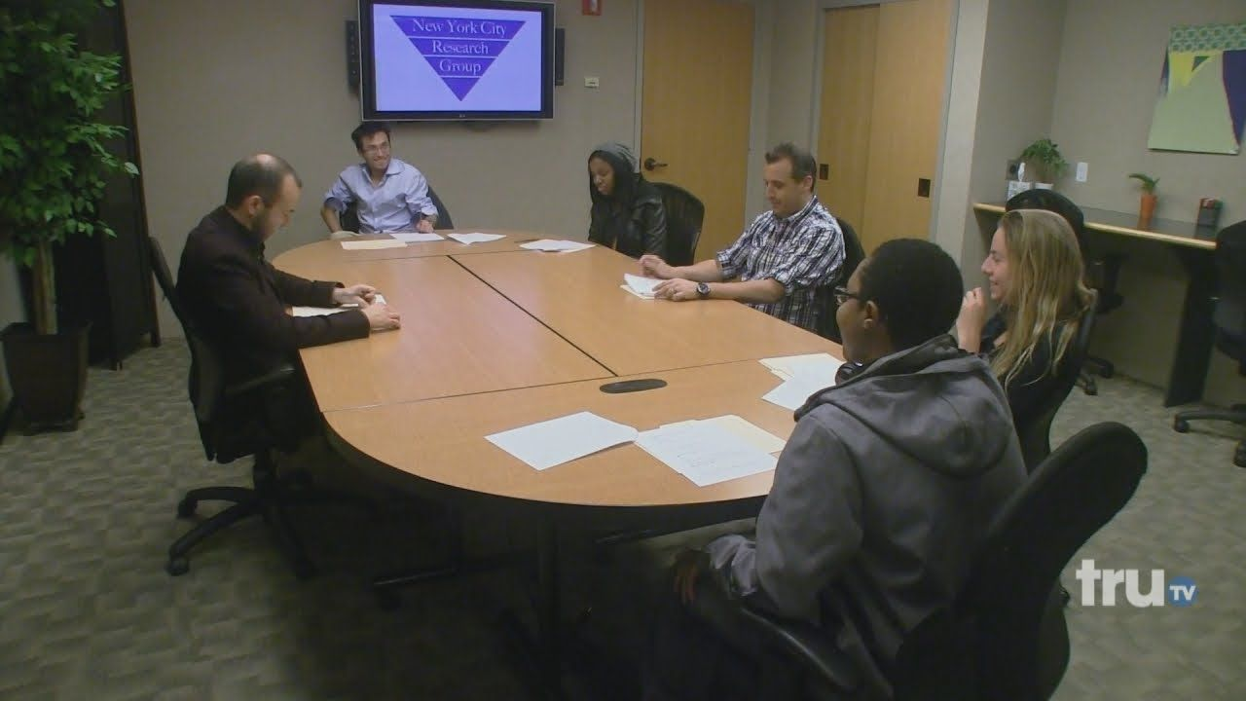
Introduction
4 students : 2 seniors, 1 freshman, 1 graduate
Roles : Moderator-Harsh, Observer-Gram, Timekeeper-Wenjun, Notekeeper-Tanzi
Goal : Facilitate conversations between the participants and the moderator to gain insight into why students chose VT. These insight should inform us of potential design ideas
Notes:
During our focus group, we have four participants, 2 seniors, 1 freshman and 1 grad student. In our team, Harsh was the moderator, Gram was observer, me was timekeeper and Tianzi was note keeper. And our goal was to build up a comfortable conversation in order to gain insights into why they chose Virginia Tech and why they think VT is attractive.

Slide 4

Content: Our process
4 phases:
Icebreaker
Background questions
Key Questions
Addendum Questions
We started clockwise around the table at first, once everyone is comfortable the participants will jump in voluntarily resulting in an interactive conversation.
Kept track of body language, most notably nodding.
Notes:
Picture: https://advantagecaredtc.org/advantage-care-health-centers-patient-focus-group/
We separate our focus group activity into 4 phrases, icebreaker, background questions, key questions and addendum questions. After we finished our self-introduction, they introduced themselves in clockwise order. When move to questions part, they could feel free to voluntarily answer those questions, this part was more like a normal conversation between friends. And we keep track their body language and answers during their conversation with our moderator.

Slide 5
Content: Our key questions
About the Campus:
How would you persuade a friend to come to VT with you?
What kind of activities do you like doing around VT?
Do you like the food on campus?
How do you travel around campus?
Do you like go to hangout outside the campus?
What did you dislike about virginia tech?
Why and How did you choose to attend Virginia Tech?
Mobile & Technology:
What if AR technology used in a mobile tour, will you be engaged?
What’s your experience with mobile device?
Do you usually watch anything related to Virginia Tech through your mobile device?
What mobile device/app you like to use?
What if smell or other sense can be used for a tour, would you like that?
What if sound can be added in a virtual tour, will it catch your attention? What sound would you like to be included?
Notes:
We listed some key questions we asked on screen. They are separated into campus part and technology part. On campus part, we asked questions like how would you persuade a friend to come to VT with you? What kind of activities do you like doing around VT? What did you dislike about virginia tech? How do you travel around campus? For the mobile and technology part, we asked their experience in using mobile device, what mobile device/app you like to use? Would they prefer smell or other sense used in a tour?

Slide 6
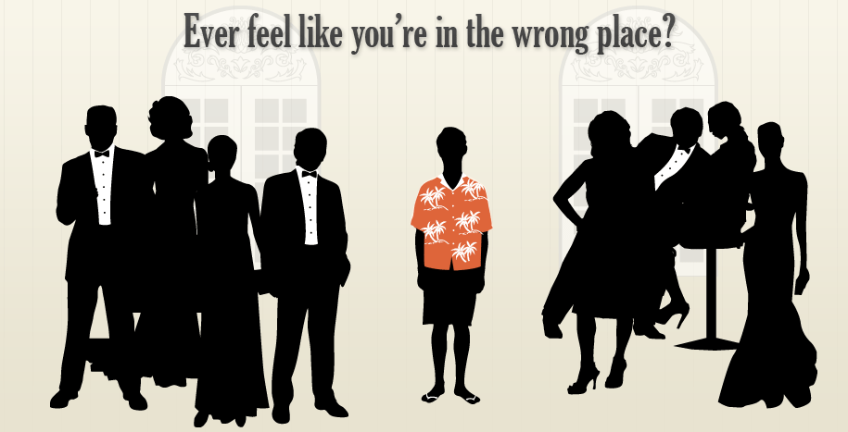
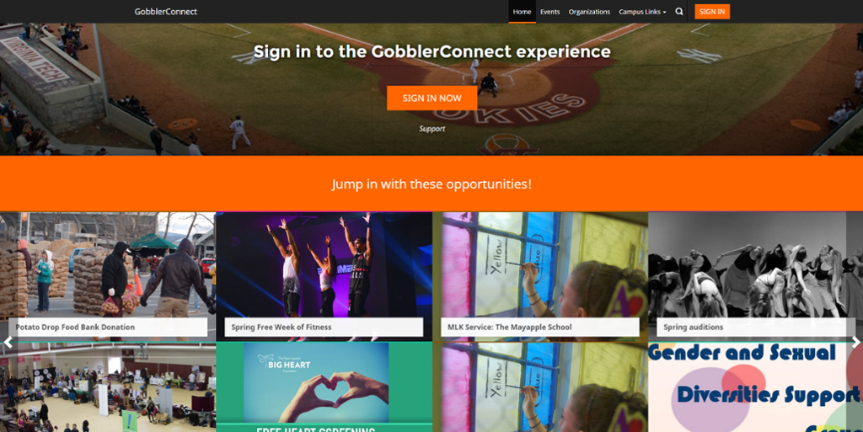
Key Takeaways: Why they chose VT
Homely feeling/Non competitive atmosphere
Hokie pride and spirit/ Encouragement from friends and family
Cheap Tuition/Best bang for your buck
“There is something for everyone”
Notes:
Our key takeaways, from time period perspective, includes two stages, the first one is before they get enrolled to virginia Tech, what are their first feelings about virginia tech and the reasons why they choose virginia tech. after their arrival, what are the activities or introductions that make them getting familiar with here.
The common reason why they choose vt: they have the homely feelings here, especially non competitive atmosphere for undergraduate students. the hokie pride and spirit, as well as the encouragement from friends and family. We have cheap tuition because we are public school here. And the various options for different interests, handrands of clubs, there is something for everyone.
The undergraduate are attracted by the sports and athlete here, and for the ones who don't really like sports, they like the atmosphere of watching or joining the events.

Slide 7
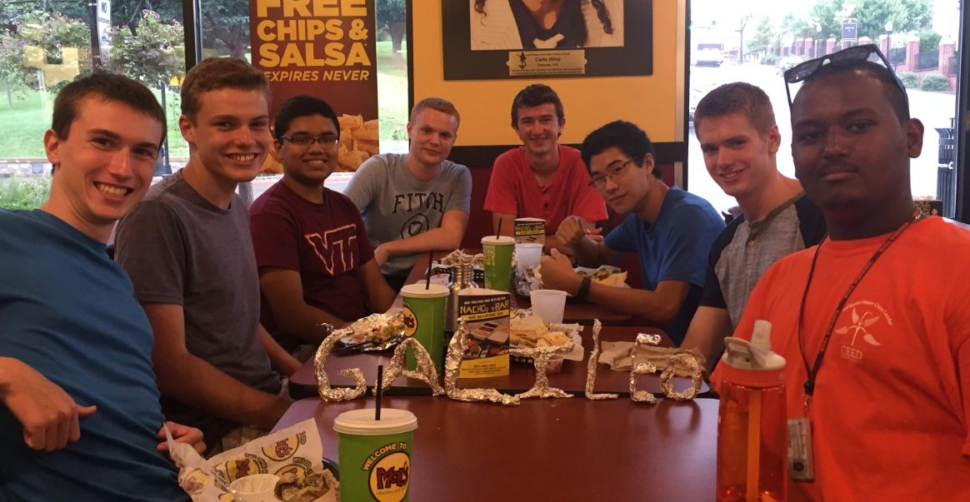
Key Takeaways: Introduction to VT
Prefer more specific tours than a generic one the school provides.
Hypatia and Galileo being an integral part of introducing students to what VT is about.
Buildings that have lasting impressions:
Lane Stadium, Torgersen Bridge, Drill Field, sunset at the War Memorial Pylons
4. Must do activities:
Enter sandman, Hiking in the Cascades,
Tailgating, Gobblerfest.
Notes:
After they join VT, there will be tours for them. During the focus group, they mentioned that they prefer more specific tours than a generic one. Hypatia and Galileo is an integral part of introducing students to what VT is about.
Gobblerfest is an annual festival intended to engage students in campus activities and connect with the surrounding community

Slide 8
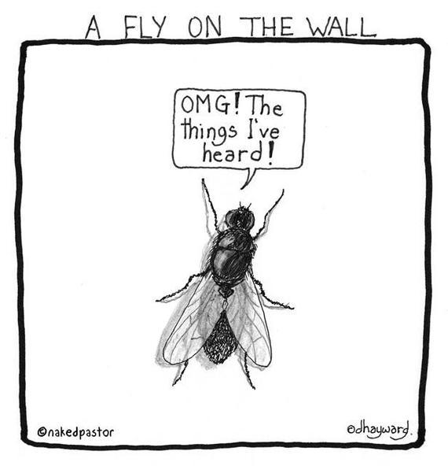
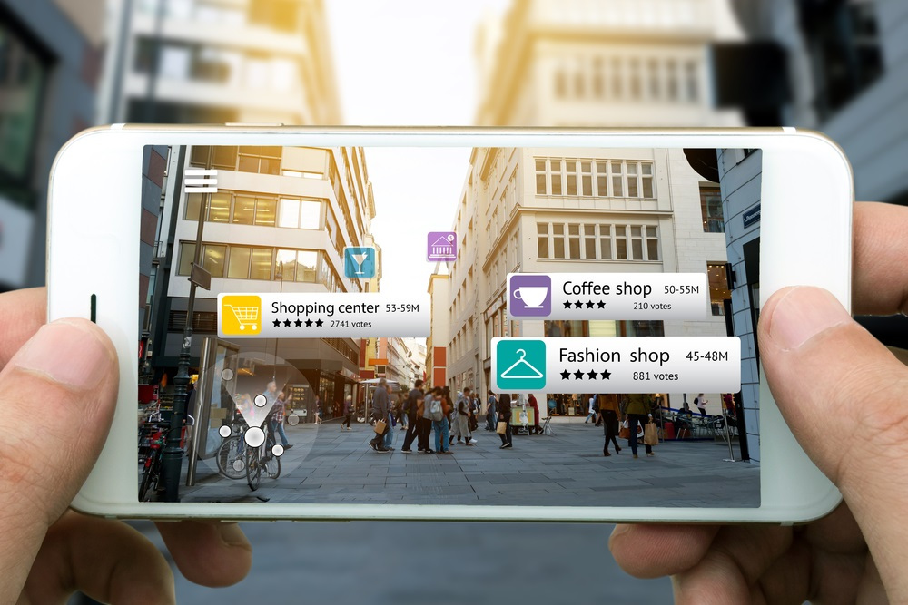
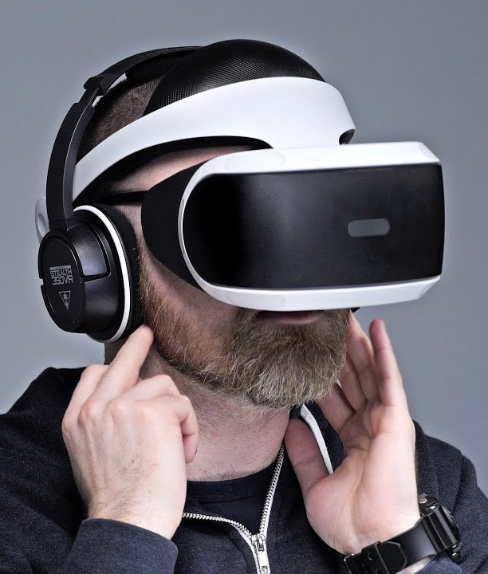
Key Takeaways: Mobile devices/tourism
Smartphones an integral part of everyday life.
Prefers cloud-based apps that can by access anywhere by anything
Auditory or Olfactory is an desirable add-on to a “tour guide” experience
Students would like a “fly on a wall” experience of a class prior to choosing a school
Feeling of space and ambient noise helps with the immersion.

Slide 9
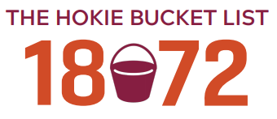
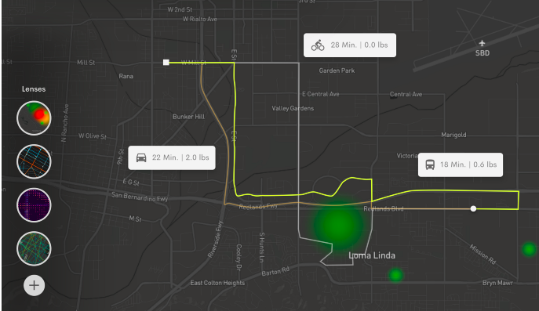
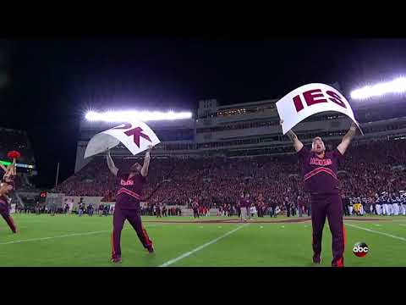
Design Ideas
AR/VR experience with high customizability
Include high impact events such as enter sandman, class experience, hiking trails, and gobblerfest.
Curated map/Hokie bucket list app
Include other sensory systems to enhance the experience

Slide 10
Reflections on the focus group
Positives
Participants are very cooperative
Participants show their strong passion to Virginia Tech.
Clear opinions
Most Questions were answered
Common ground on several topics
Positive group interaction overall
Body languages reinforced our insight
Consistency of the conversations
Talked of specific things and experiences during the interview.
Room for Improvement
Failure to create an intimate atmosphere with group due to space and time management
Lack of parents /alumni /international /graduates’ opinions
Some information may not be useful for design.
Less engagement on some topics
Moderator may have needed to probe deeper into their interests/motivations
Pace of conversation was erratic at times.
Some of the responses may have been what they felt “we wanted to hear”

Slide 11
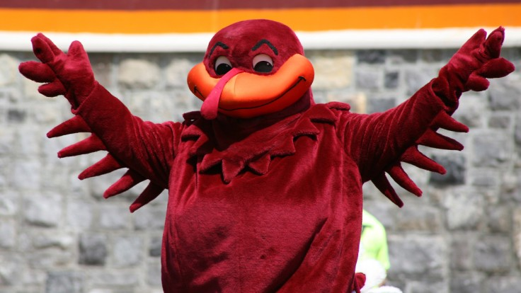
Conclusion
Conducting the focus group
Valuable insights:
Bring them to VT: feeling of home, tuition, variety of activities, hokie pride.
Favourites after being here for years: tours, building, bucket list.
Mobile tourism
Design ideas
Reflection

Slide 12

Thank you!

